Slide 1

Kaplan Agile Development
August 2011

Slide 2
Overview
It’s All About The Team
  Team Members Explained
  Extended Team Members Explained
Agile Process

Slide 3


The Team Defined – Pigs or Chickens?
Pigs – The Team – are committed to delivering the project since “their bacon is on the line”
  Scrum Master
  Developers
  QA
  PO
Chickens are interested in the project – the needs, ideas, and influences of the chickens are taken into account but not in any way letting it affect, distort, or get in the way of the team
  PM
  Business and IT Functional Managers
  Business Stakeholders

Slide 4
Team Members Explained
Product Owner
SCRUM Master
Technical Dev Lead
Developer
QA Lead
QA Tester

Slide 5
Extended Team Members Explained
Project Manager
Business Stakeholders
Functional Manager
Details around extended team members who are involved or informed about the process is detailed in the SDLC maintained by the IT PMO

Slide 6
It’s All About The Team
Together the entire team is responsible for delivering work from start to finish and from idea to deployment.
The Team is …
  Self Organizing
    Through collaboration
  Empowered
    To make good decisions on their own
    To raise concerns if something is wrong
  Accountable to Each Other
    By relying on each other to complete work
    By working to resolve issues at the lowest level
  Responsible for Incorporating Continuous Improvement
    By constantly promoting learning and ideas

Slide 7
Product Owner
Create and maintain the product backlog - “the what”
Continuously prioritize the backlog and release plan according to project progress
Works closely with the SCRUM team in decomposing acceptance criteria into user stories that are granular enough to be consumed by the team in a single sprint
Provides vision and goals for each release and sprint
Represents the cumulative voice of the customer / business
Single point of contact for all requirements (user stories) and direction during the sprint
Inspects the product progress at definition of done and has complete authority to accept and reject work

Slide 8

SCRUM Master
Manage SCRUM Process
Shield Team from External Interferences
Remove and Escalate Impediments
Work closely with PO
Facilitate Sprint Meetings
Ensure stories meet the team minimum requirements
Incorporate continuous improvement
Pitch in where necessary to complete stories

Slide 9
Technical Lead
Participate in Sprint Planning meetings
Participate in Sprint Demo Review and Retrospective
Have a technical overview of the project
Remove technical impediments
Write code
Ensure code reviews are completed
Ensure DB code review are completed – when applicable
Pitch in where necessary to complete stories

Slide 10
Developers
Participate in Sprint Planning meetings
Participate in Sprint Demo Review and Retrospective
Contribute technical knowledge to build solutions to deliver user stories
Write Code
Provide feedback to improve process
Pitch in where necessary to complete stories

Slide 11
QA Lead
Participate in Sprint Planning meetings
Participate in Sprint Demo Review and Retrospective
Coordinate with team to write Acceptance Test with Developers
Coordinate with offshore to write Test Cases
Coordinate QA Off Shore Resources
Provide feedback to improve process
Pitch in where necessary to complete stories

Slide 12
QA Testers
Participate in Sprint Planning meetings
Participate in Sprint Demo Review and Retrospective
Write Test Cases
Run Test Case
Provide feedback to improve process
Pitch in where necessary to complete stories

Slide 13
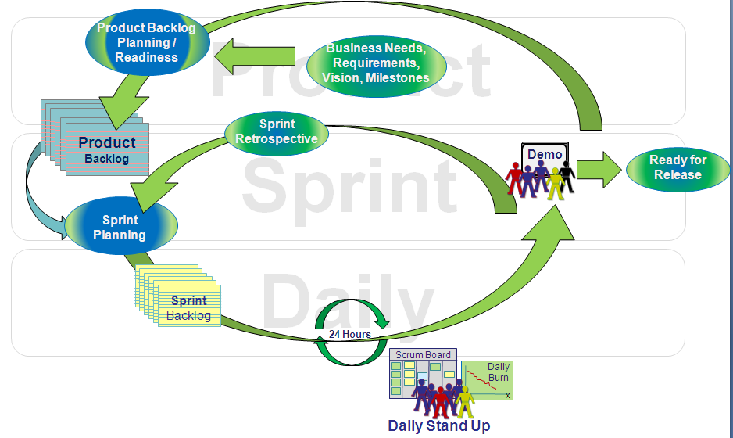
Agile SCRUM Flow

Slide 14
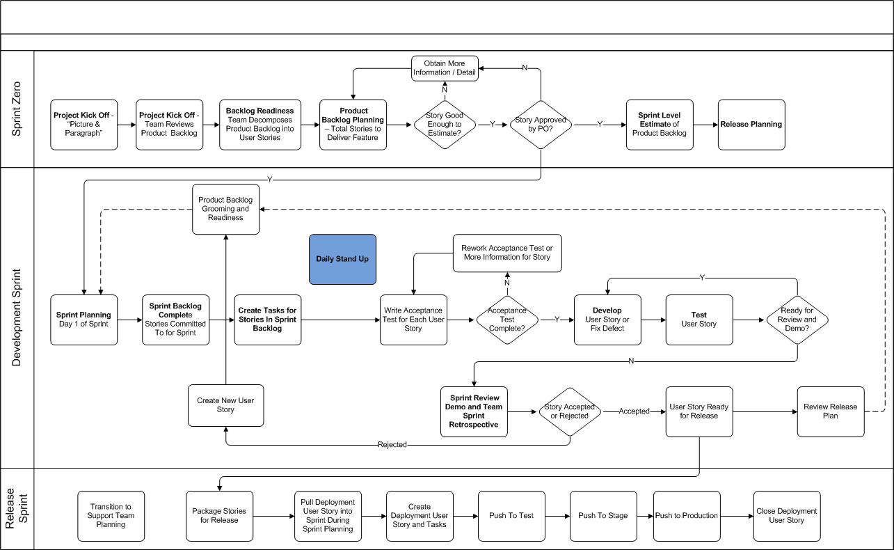
Kaplan Agile – Sprint Zero to Release
Notes:
This supplements the SDLC maintained by the PMO.

Slide 15
Sprint Zero
Sprint Zero is the preliminary sprint exclusively dedicated to preparing for the first sprint.
Objective |
  High level architectural/ infrastructure design
  Environmental readiness
  Provide estimates to develop sprint level release schedule
  Prioritized product backlog of user stories ready for sprint 1 planning

Slide 16
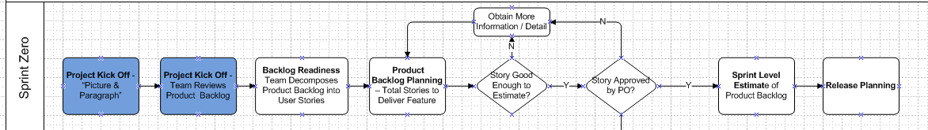
Sprint Zero – Project Kick Off
PO presents project vision and goal to team
  “Picture and Paragraph”
    May include a process diagram with a brief explanation
    List of features explaining the goal
Team reviews product backlog individually or together to get an overview of the project.

Slide 17
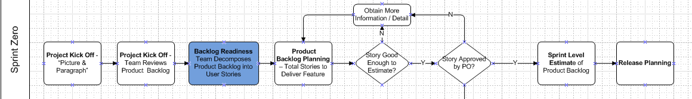
Sprint Zero – Product Backlog Readiness
Team decomposes product backlog into sprint backlog
  Story slicing and backlog readiness sessions occur, as required, to compose sprint backlogs
  Attended by the Team
    Others invited to observe
  ! PO ensures all user stories are complete and ready for the team to consume
  Best practice to have at least 2 sprints of backlog fully fleshed out and ready for the team to consume

Slide 18
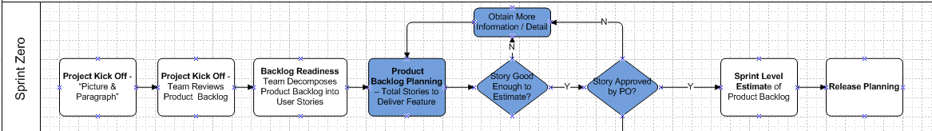
Sprint Zero – Product Backlog Planning
Team plans all stories in product backlog
  Attended by the Team
    Others invited to observe
  If a story can’t be estimated the PO provides clarification
Planning Poker is used by each developer and QA resource to estimate each user story
  Each team member displays their estimate
  Discussion follows to obtain consensus on the estimate
  ! These estimates are based on what is known at the time the estimate is given

Slide 19
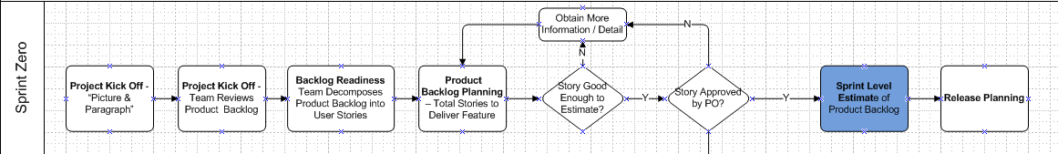
Sprint Zero – Sprint Level Estimates
Estimates from product backlog planning are used to provide a sprint level estimate for the project
  This estimate must be realistic
  Consideration for things that “could” happen should not be included
Sprint level estimate is provided for review and approval to key stakeholders
  PM
  PO
  Technology Management
  Other stakeholders deemed appropriate

Slide 20
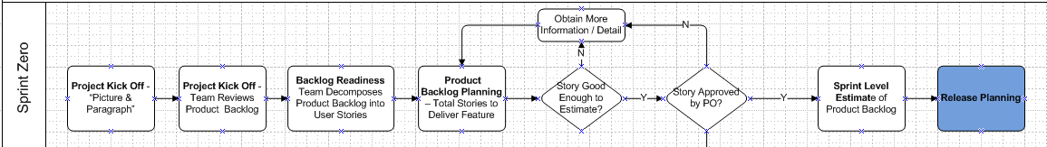
Sprint Zero – Release Planning
A release is a collection of “minimum marketable features” that can be delivered together within the same time frame to provide value to the business
The release plan describes the iterative release of all product backlog items
Each release is comprised of a number of sprints required to the release
The team meets to coordinate the release schedule based on the sprint level estimates provided
  PO must know the business priorities in order to prioritize what functionality will be released

Slide 21
Development Sprints – Objective
Development sprints is where actual development and QA work happens
Objective |
  Deliver stories committed to during sprint planning for acceptance by the PO

Slide 22
Development Sprints – Continued Backlog Readiness
SM and PO continue to flush out product backlogs
  PO continues to prioritize the backlog based on release progress, risk assessment, or changes in the business priority
PO reaches out to SMEs for product related questions during sprints posed by the team during the sprint
  PO must be available to respond questions in a timely fashion
PO can accept or reject completed work during sprint
  The sooner the PO can see completed the work the easier it is to adjust backlog

Slide 23
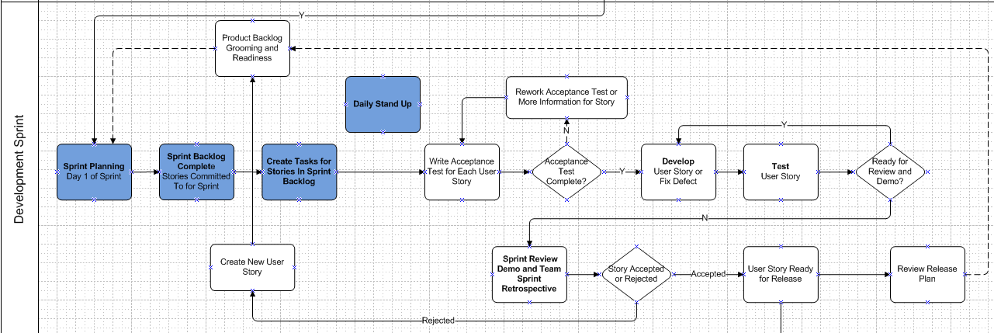
Sprint Planning – Day 1 of Sprint
Attended by the Team
  Others invited to observe
PO describes the highest priority user stories
Teams asks questions to ensure a clear expectation of the user story

Slide 24
Sprint Planning – Day 1 of Sprint
Planning Poker is used by each developer and QA to estimate each user story
  Each team member displays their card (estimate), discussion follows to obtain consensus to provide a team estimate
Developers and QA define tasks for each story assigned to them
  Each task is given an hour estimate
! Stories pulled into the sprint are committed to for delivery in that Sprint

Slide 25
Daily Stand Up
Stand Up Is ….
  Conducted daily
  An opportunity for the team to discuss accomplishments from the previous day and what will accomplished today.
  A way to provide team member accountability to each other.
Stand Up Is Not ….
  Used to discuss problems and resolve issues.
    These conversations are taken off line to resolve

Slide 26
Daily Stand Up - Rules of Engagement
No side conversations
  No distractions for those giving their status
Everyone stands up
  Keeps everyone focused and reduces the potential of getting off track
No laptops
Discussions about impediments and issues happen after standup
  Keeps the meeting focused and as short as possible

Slide 27
Daily Stand Up - 3 Questions Answered
1. What did you do yesterday?
  “Yesterday I worked on the import process for story 123, I have 6 hours left to complete”
    Hours remaining should match what is entered in the TFS
2. What will you do today?
  “Today am going to complete story 123”
3. Are there any impediments/blockers in your way for the story?
  “I have no impediments for story 123”
  OR
  “I have an impediment for story 123, environment is being refreshed”

Slide 28
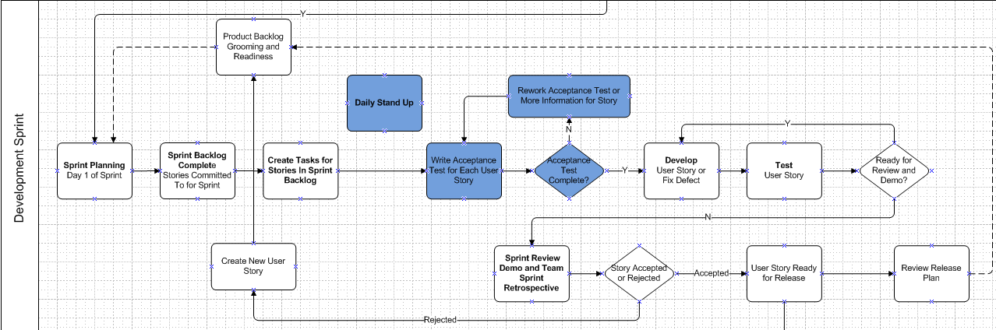
Acceptance Test
QA works with development to write acceptance test
  Serves as a guide for developers to better interpret the requirements of the story
  Helps PO verify and validate the story is implemented as intended

Slide 29
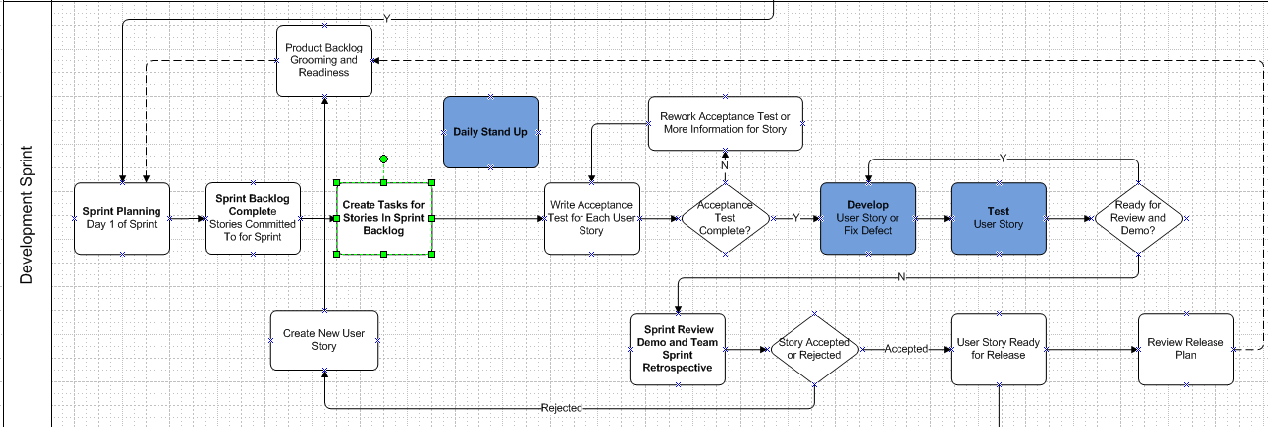
Work – Develop and Test
Developers work to code user stories
QA tests user stories when completed by development
Defects found are coordinated with development for resolution

Slide 30
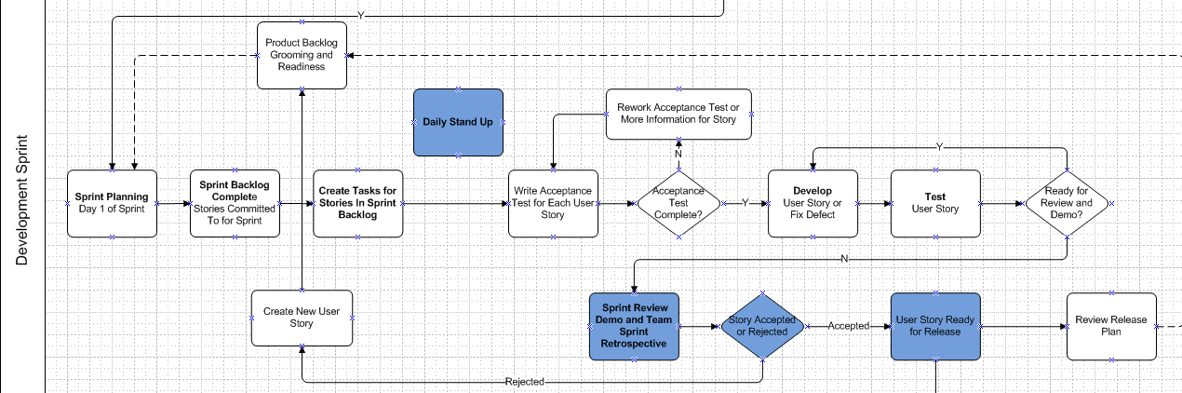
Sprint Demo Review
Sprint Demo Review
  The team demo’s functionality completed during sprint
  PO accepts or rejects stories
  Upon acceptance the story is Ready for Release

Slide 31
Definition of Done – Ready for Release
Done in Dev is our current definition of done
  Meaning the user story meets the acceptance criteria documented in the user story
  It doesn’t necessarily mean that all regression and integration has been completed
The deployment user story is created when code is packaged and ready to be moved to production.
  This includes regression and integration activities in the applicable environments

Slide 32
Sprint Retrospective
Sprint Retrospective
  Opportunity for team to review what the team did good, what they need to stop doing, and what they need to start doing
  Incorporates learnings back into the process to allow the team to improve
Signals the end of the current sprint and triggers sprint planning for the next sprint

Slide 33
Sprint Retrospective
Sprint Retrospective
  Opportunity for team to review what they team did good, what they need to stop doing, and what they need to start doing
  Incorporates learnings back into the process to allow the team to improve

Slide 34
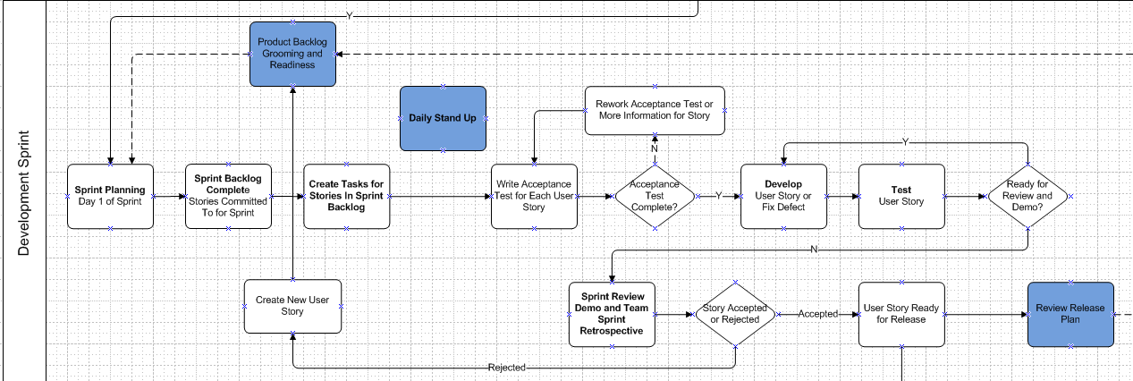
Review Release Plan
Review Release Plan
  Critical component of managing the release is revisiting the release plan in conjunction with the product backlog at the end of each sprint

Slide 35
Product Backlog Grooming and Readiness
Backlog Grooming and Readiness
  Take places during the sprint and/or when deemed appropriate by the team
  Ensures the backlog is healthy and prioritized so the team can consume stories during the next sprint planning session

Slide 36
Release Sprint
Release sprint is a normal development sprint with a DUST
Objective |
  Migrate packaged code for the release through the applicable environments to Production

Slide 37
Release Sprint
Because stories are ready for release doesn’t mean functionality is automatically pushed to Production
A deployment user story (DUST) is created to track the progression of the stories/code packaged from development through the required environments.
The DUST in pulled into a development sprint to provide visibility that the team is working to get code to production as well as work on other stories

Slide 38
Transition to Support Team
Because stories are ready for release doesn’t mean functionality is automatically pushed to Production
A deployment user story (DUST) is created to track the progression of the stories/code packaged from development through the required environments.
The DUST in pulled into a development sprint to provide visibility that the team is working to get code to production as well as work on stories

